Slide 1

Information Systems: A Manager’s Guide to Harnessing Technology
Developer Name:

Slide 2

Learning Objectives - A
Describe how the technologies of the Internet combine to answer these questions: What are you looking for? Where is it? And how do we get there?
Interpret a URL, understand what hosts and domains are, describe how domain registration works, describe cybersquatting, and give examples of conditions that constitute a valid and invalid domain-related trademark dispute.
Describe certain aspects of the Internet infrastructure that are fault-tolerant and support load balancing.
Discuss the role of hosts, domains, IP addresses, and the DNS in making the Internet work.

Slide 3
Internet 101: Understanding How the Internet Works
internet service provider (ISP): Organization or firm that provides access to the internet.
  Providers connect to one another, exchanging traffic and ensuring that messages can get to any other computer that’s online and willing to communicate.
The internet was designed to be redundant and fault-tolerant—if one network, connecting wire, or server stops working, everything else should keep on running.

Slide 4
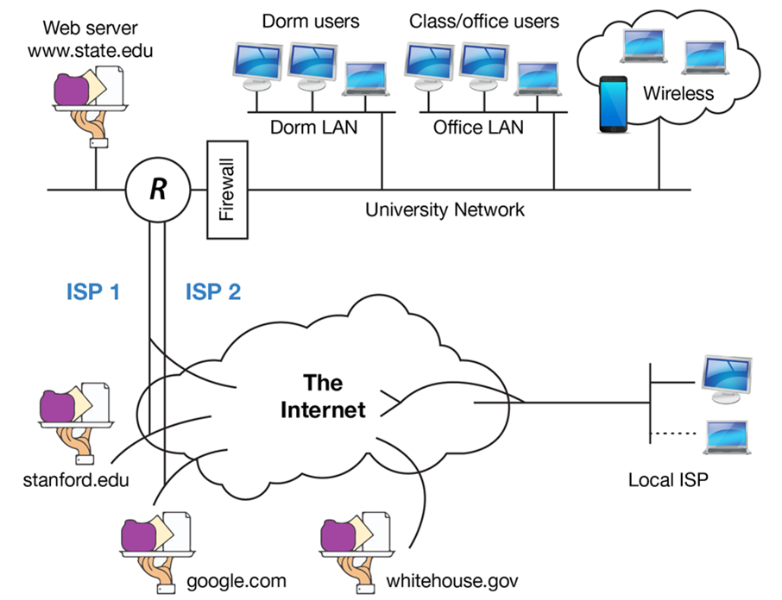
The Internet Is a Network of Networks
In this diagram, the “state.edu” campus network is connected to other networks of the Internet via two ISPs.

Slide 5
The URL: “What Are You Looking For?”
URL (uniform resource locator): Identifies resources on the internet along with the application protocol needed to retrieve it. Often used interchangeably with “Web address.”
protocol: Enables communication by defining the format of data and rules for exchange.
  hypertext transfer protocol (http): Application transfer protocol that allows Web browsers and Web servers to communicate with each other.
  SMTP, or simple mail transfer protocol, which is a server to hold e-mail.
  FTP: Application transfer protocol that is used to copy files from one computer to another.

Slide 6
Anatomy of a Web Address
The URL displayed really says, “Use the Web (http://) to find a host server named ‘www’ in the ‘nytimes.com’ network, look in the ‘tech’ directory, and access the ‘index.html’ file.”

Slide 7
Host and Domain Names
The domain name is the name of the network you’re trying to connect to (usually represents an organization).
The host is the computer you’re looking for on that network.
Many domains have lots of different hosts.
None of these are case-sensitive.

Slide 8
Host and Domain Names: A Bit More Complex than That
load balancing: Distributing a computing or networking workload across multiple systems in order to avoid congestion and slow performance.
fault tolerance: Systems that are capable of continuing operation even if a component fails.

Slide 9
I Want My Own Domain
To stake your domain name claim in cyberspace, a firm called a domain name registrar can be used.
    Pay a registrar for the right to use that name.
    The right is renewable over time.
    Some simply register domain names while others are able to run a website on their Internet-connected servers for a fee (web hosting service).
Web hosting services: A firm that provides hardware and servers to run the websites of others.
ICANN (Internet Corporation for Assigning Names and Numbers: A nonprofit governance and standards-setting body that accredits registrars throughout the world.

Slide 10
IP Addresses and the Domain Name System: “Where Is It? And How Do We Get There?”
IP address: Value used to identify a device that is connected to the Internet.
  Can be used to identify a user’s physical location.
  The still widely used format is IPv4 and is expressed as four numbers (from 0-255), separated by periods: 216.3.128.12
Value used to identify a device that is connected to the Internet

Slide 11
The Internet is Full—We’ve Run Out of IP Addresses
NAT (network address translation: Conserves IP addresses by mapping devices on a private network to single Internet-connected devices that acts on their behalf.
  Helps delay the impact of the IP address drought.
  Only long-term solution is to shift to a new IP scheme—IPv6 increases the possible address space from the addresses used in the current system.
    IPv6 is not backward compatible with IPv4 and transition has been very slow.
    When IPv6 is deployed, some of the benefits may include potentially improving speed, reliability, and security of the internet.

Slide 12
The DNS: The Internet’s Phonebook
domain name service (DNS): Internet directory service that allows devices and services to be named and discoverable.
  Distributed database that looks up host and domain names and returns the actual IP address for them.
  Likened to a big, hierarchical set of phone books capable of finding Web and email servers and more.
    These “phone books” are called nameservers and they work together to create the DNS.
  The system also remembers what’s it’s done.
    cache: Temporary storage space used to speed computing tasks.
Internet directory service that allows devices and services to be named and discoverable

Slide 13
Finding an IP Address

Slide 14
But What if the DNS Gets Hacked?
Usually happens when system security updates are not installed correctly or in a timely manner.
Cache poisoning exploits a hole in DNS software, redirecting users to sites they didn’t request.
  In many cases users are redirected imposter sites for the purpose of harvesting passwords and credit card data.

Slide 15
Learning Objectives - B
Understand the layers that make up the Internet—application protocol, transmission control protocol, and Internet protocol—and describe why each is important.
Discuss the benefits of Internet architecture in general and TCP/IP in particular.
Name applications that should use TCP and others that might use UDP.
Understand what a router does and the role these devices play in networking.
Conduct a traceroute and discuss the output, demonstrating how Internet interconnections work in getting messages from point to point.
Understand why mastery of Internet infrastructure is critical to modern finance and be able to discuss the risks in automated trading systems.
Describe VoIP, and contrast circuit versus packet switching, along with organizational benefits and limitations of each.

Slide 16
TCP/IP: The Internet’s Secret Sauce
TCP (transmission control protocol): Works at both ends of internet communication to ensure a perfect copy of a message is sent.
  Slices up the Web page into smaller chunks.
    packets (or datagrams): Unit of data forwarded by a network. All internet transmissions are divided into packets.
IP (internet protocol): Routing protocol that is in charge of forwarding packets on the internet.
  The relay work is done via routers: A computing device that connects networks and exchanges data between them.

Slide 17
TCP/IP in Action

Slide 18
UDP/VOIP
UDP (user datagram protocol): Operates instead of a TCP in applications where delivery speed is important and quality can be sacrificed.
VoIP: Transmission technologies that enable voice communications to take place over the Internet and private packet-switched networks.

Slide 19
What Connects the Routers and Computers?
Routers are connected wirelessly or by cables.
  Copper cables with transmissions sent through via electricity.
  Fiber-optic lines—glass lined cables that transmit light.
peering: When separate ISPs link their networks to swap traffic on the Internet.
  Takes place at neutral sites called Internet exchange points (IXPs).

Slide 20
Finance Has a Need for Speed
colocation facility: Provides a place where the gear from multiple firms can come together and where the peering of Internet traffic can take place. Equipment connecting in colos could be high-speed lines from ISPs, telecom lines from large private data centers, ore even servers hosted in a colo to be closer to high-speed Internet connections.
Less than a decade ago, eighty milliseconds was acceptably low latency, but now trading firms are pushing below one millisecond into microseconds, and soon, nanoseconds.
But also recognize that this kind of automated trading comes with risks. Systems that run on their own can move many billions in the blink of an eye, and the actions of one system may cascade, triggering actions by others.

Slide 21
Watching the Packet Path via Traceroute
Traceroute repeatedly sends a cluster of three packets starting at the first router connected to a computer.
  Builds out the path that packets take to their destination.
Built into all major desktop operating systems.
Several Web sites will run it between locations.
Neat way to explore how the Internet works.

Slide 22
Traceroute Between Irish Firm Vistatec and Boston College

Slide 23
There’s Another Internet?
Internet2 is a research network created by a consortium of research, academic, industry, and government firms.
These organizations have collectively set up a high-performance network running at speeds of up to one hundred gigabits per second to support and experiment with demanding applications.

Slide 24
Learning Objectives - C
Understand the last-mile problem and be able to discuss the pros and cons of various broadband technologies, including DSL, cable, fiber, and various wireless offerings.
Describe mobile technologies known as 4G and the emerging 5G.
Understand the issue of Net neutrality and put forth arguments supporting or criticizing the concept.

Slide 25
Last Mile: Faster Speed, Broader Access
last mile: Technologies that connect end users to the Internet. The last-mile problem refers to the fact that these connections are usually the slowest part of the network.
Internet backbone: High-speed data lines that interconnect and collectively form the core of the Internet.
Amdahl’s Law: System’s speed is determined by its slowest component.
broadband: High-speed Internet connections.
bandwidth: Network transmission speeds that are expressed in some form of bits per second (bps).

Slide 26
Cable Broadband
Uses thick copper wire to offer broadband access.
  coaxial cable: Insulated copper cable used by television providers.
  Has shielding that reduces electrical interference.
    Allows cable signals to travel longer distances without degrading and with less chance of interference.
Limitation: Requires customers to share bandwidth with neighbors.

Slide 27
DSL: Phone Company Copper
digital subscriber line (DSL): Broadband technology that uses the wires of a local telephone network.
  Speeds vary depending on the technology deployed.
  Limitation—uses standard copper telephone wiring that lacks the shielding used by cable.
Broadband over power line (BPL) technology has been available for years.
  Deployments are few because it is considered to be pricier and less practical than alternatives.

Slide 28
Fiber: A Light-filled Glass Pipe to Your Doorstep
Fiber to the home (FTTH): Broadband service provided via light-transmitting fiber-optic cables.
  Fastest last-mile technology and works easily over long distances.
  Limitations:
    Need to build fiber infrastructure from scratch.
    Cost of buildout is enormous.

Slide 29
Wireless
Mobile wireless service from cell phone access providers is delivered via cell towers.
Providers require a wireless spectrum.
  wireless spectrum: Electromagnetic frequencies used for wireless communication.
    Most mobile cell phone services have to license spectrum.
    High-stakes regional bidding wars whenever governments put new spectrum up for license
Mobile phone services usually have a number, followed by a G (for generation). The bigger the “G,” the faster and more reliable.
Incompatible worldwide 3G technologies has been replaced by 4G mobile networks.
The winner in 4G technologies is LTE (long-term evolution).
  US average download speeds above 40 Mbps and upload speeds near 20 Mbps are now common.
Carriers have begun rolling out 5G services.
  Faster, more reliable, and have higher overall capacity than 4G networks.

Slide 30
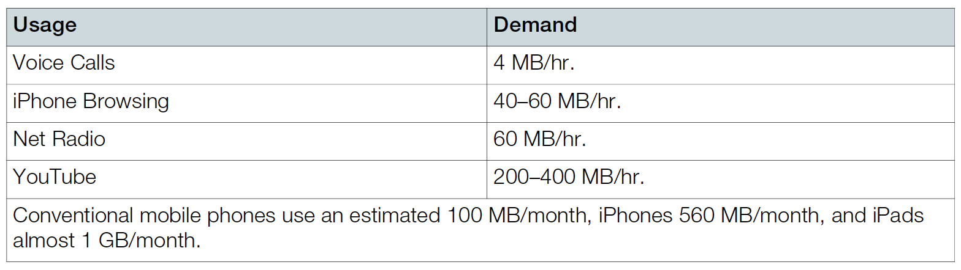
Average Demand Usage by Function

Slide 31
5G: A Slow Roll-out to a Faster Wireless Network
New 5G networks offering gigabit-plus speeds will provide a credible rival to home television and data packages offered by cable firms.
Infrastructure and devices need to be upgraded.
Former FCC Chair Tom Wheeler says this means that “5G may be the last physical network overhaul in generations as upgrades will now be only a matter of replacing software and low-cost, commodity components.”
5G may be a catalyst for all sorts of applications, including self-driving automobiles, emergency response communication, telemedicine, “bespoke” network offerings for VR, AR, and high-speed game streaming, and smart city sensors for things like traffic routing, air and water monitoring, and community safety.

Slide 32
Satellite Wireless and Schemes to Reach the Remote
Terrestrial wireless are provided by earth-bound base stations like cell phone towers.
  Possible via satellite.
First residential satellite services were only used for downloads.
Later some services were based on satellites in geosynchronous earth orbit (GEO).
O3b has already begun to provide “fiber-quality” wireless service to underserved portions of the developing world, as well as others needing connectivity outside traditional cell networks (cruise ships and US Navy).

Slide 33
Wi-Fi and Other Hotspots
Wi-Fi: Wireless local-area networking devices.
  Stands for wireless fidelity.
  Wi-Fi antennas are built into their chipsets.
  To connect to the Internet, a device needs to be within range of a base station or hotspot.
Wi-Fi base stations used in the home are usually bought by end users.
They are then connected to a cable, DSL, or fiber provider.
Wi-Fi equipped mobile devices also offer an opportunity to act as a personal hotspot.
  Connects to the Internet via the cell network.
  Allow nearby devices to also connect to the Internet.
Bluetooth: A standard for short-range wireless connectivity, typically meant to eliminate cabling used for things like speakers, printers, cameras, and other devices.

Slide 34
Net Neutrality: What’s Fair?
Net neutrality is the principal that all Internet traffic should be treated equally.
  Access providers have wanted to offer varying coverage, depending on the service used and bandwidth consumed.
  Internet content providers worry that without strong neutrality rules, ISPs may block content or favor their own offerings above rivals.
  If network providers move away from flat-rate pricing toward usage-based pricing, this may limit innovation.

